Slide 1
Introduction to Information Systems and Programming
Inheritance and Polymorphism
[some materials adopted from Liang, Introduction to Java Programming]

Slide 2
Inheritance: motivations
Define classes for circles, rectangles, triangles
They have common features / properties / behaviors
What is the best software design to avoid redundancy?
Inheritance
Programming constructs to allow inheriting code from one class (superclass) to another class (subclass)
Enables you to define a general class (superclass) and later extend it to more specialized classes (subclass)

Slide 3
Superclasses and Subclasses
Example: GeometricObject, Circle
Class Circle extended from Class GeometricObject
Use keyword extends
Superclass / parent class / base class
Subclass / child class / derived class / extended class
Subclass inherits all accessible data fields and methods from the superclass, except constructors

Slide 4
Subclass
In a subclass inherited from a superclass, you can
Add new properties
Add new methods
Override the methods of the superclass

Slide 5
Activity
Implement subclass Rectangle by extending from GeometricObject
Subclass attributes: double width, height
Implement accessors / mutators
Implement getArea() / getPerimeter()

Slide 6
Superclasses and Subclasses
A subclass is not a subset of its superclass; often, a subclass contains more information and methods than its superclass
Inheritance is used to model is-a relationship (Circle is a GeometricObject)
Java allows only single inheritance: A Java subclass inherits only from one superclass (multiple inheritance can be achieved through interface)

Slide 7
Advantage of inheritance
Avoid redundancy
Different classes may have common properties and behaviors
Easy to maintain
Easy to comprehend
Class relationship documented in the inheritance tree

Slide 8
super
Superclass’s constructors are not inherited
Invoked explicitly or implicitly using super keyword
If the keyword super is not explicitly used, the superclass’s no-arg constructor is automatically invoked

Slide 9
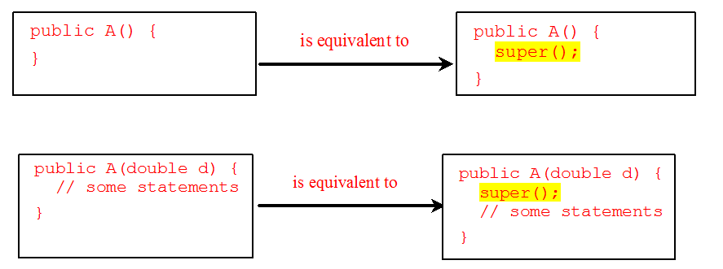
Superclass’s constructor is always invoked
A constructor may invoke an overloaded constructor or its superclass constructor. If neither is invoked explicitly, the compiler puts super() as the first statement in the constructor

Slide 10
super
To call a superclass constructor
Must use super to call the superclass constructor
Invoke the superclass constructor’s name causes a syntax error
super needs to appear first in the constructor
Call to constructors (this() / super()) must be the first statement in the constructor
Keyword super can also be used to call a superclass method (why you need this? Aren’t they inherited?)

Slide 11
Constructor chaining
Constructing an instance of a class invokes all the superclasses’ constructors along the inheritance chain

Slide 12
Activity: what are printed?
public class Faculty extends Employee {
public static void main(String[] args) {
new Faculty();
}
public Faculty() {
System.out.println("(4) Faculty's no-arg constructor is invoked");
}
}
class Employee extends Person {
public Employee() {
this("(2) Invoke Employee’s overloaded constructor");
System.out.println("(3) Employee's no-arg constructor is invoked");
}
public Employee(String s) {
System.out.println(s);
}
}
class Person {
public Person() {
System.out.println("(1) Person's no-arg constructor is invoked");
}
}

Slide 13
Activity
Any error in this program?
public class Apple extends Fruit {
}
class Fruit {
public Fruit(String name) {
System.out.println("Fruit's constructor is invoked");
}
}

Slide 14
Subclass
In a subclass inherited from a superclass, you can
Add new properties
Add new methods
Override the methods of the superclass

Slide 15
Overriding Methods
Sometimes it is necessary for the subclass to modify the implementation of a method defined in the superclass
public class Circle extends GeometricObject {
// Other methods are omitted
/** Override the toString method defined in GeometricObject */
public String toString() {
return super.toString() + "\nradius is " + radius;
}
}

Slide 16
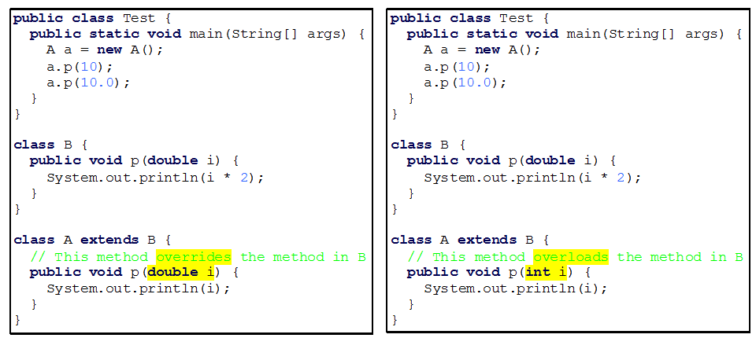
Overriding vs. Overloading

Slide 17
Overriding vs. Overloading
Overriding (left): there is only one p() in class A. Therefore the program will print 10.0 in both a.p() calls.
Overloading (right): there are two p() in class A, one inherited p from B, one overloaded p implemented in A; the printout is 10 and 20.0

Slide 18
Overriding Methods
An instance method can be overridden only if it is accessible. Thus a private method cannot be overridden, because it is not accessible outside its own class. If a method defined in a subclass is private in its superclass, the two methods are completely unrelated.
You can only override instance methods. You can hide instance attributes / static methods / static attributes (overriding vs. hiding)

Slide 19
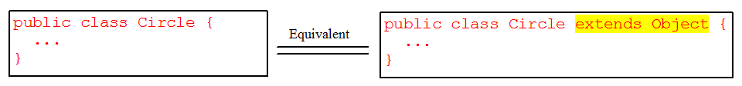
java.lang.Object
Every class is descended from java.lang.Object
If no inheritance is specified, the superclass of the class is Object
Inherited methods from Object, e.g., toString()

Slide 20
Polymorphism, Dynamic Binding
public class PolymorphismDemo {
public static void main(String[] args) {
m(new GraduateStudent());
m(new Student());
m(new Person());
m(new Object());
}
public static void m(Object x) {
System.out.println(x.toString());
}
}
class GraduateStudent extends Student {
}
class Student extends Person {
public String toString() {
return "Student";
}
}
class Person extends Object {
public String toString() {
return "Person";
}
}
Method m takes a parameter of the Object type. You can invoke it with any object.
An object of a subtype can be used wherever its supertype value is required. This feature is known as polymorphism.
When the method m(Object x) is executed, the argument x’s toString method is invoked. x may be an instance of GraduateStudent, Student, Person, or Object. Classes GraduateStudent, Student, Person, and Object have their own implementation of the toString method. Which implementation is used will be determined dynamically by the Java Virtual Machine at runtime. This capability is known as dynamic binding.
Every instance of a subclass is also an instance of its superclass, but not vice versa (e.g., Person is an Object)

Slide 21
Dynamic Binding
Dynamic binding works as follows: Suppose an object o is an instance of classes C₁, C₂, ..., C_{n-1}, and C_{n}, where C₁ is a subclass of C₂, C₂ is a subclass of C₃, ..., and C_{n-1} is a subclass of C_{n}. That is, C_{n} is the most general class, and C₁ is the most specific class. In Java, C_{n} is the Object class. If o invokes a method p, the JVM searches the implementation for the method p in C₁, C₂, ..., C_{n-1} and C_{n}, in this order, until it is found. Once an implementation is found, the search stops and the first-found implementation is invoked.
E.g., Circle is an Object

Slide 22
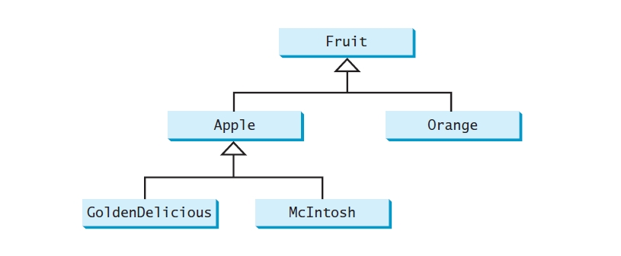


Activity

Slide 23
Activity
Fruit fruit = new GoldenDelicious();
fruit instanceof Fruit?
fruit instanceof Orange?
fruit instanceof Apple?
fruit instanceof GoldenDelicious?
fruit instanceof McIntosh?

Slide 24
Casting Object
Casting can be used to convert an object of one class type to another within an inheritance hierarchy. In the preceding section, the statement
m(new Student());
assigns the object new Student() to a parameter of the Object type. This statement is equivalent to:
Object o = new Student(); // Implicit casting
m(o);

Slide 25
Down-casting
Casting from superclass to subclass
Explicit casting must be used when casting an object from a superclass to a subclass. This type of casting may not always succeed.
Object y = new Circle();
Circle x = (Circle)y;
(Declared type vs actual type)

Slide 26
The instanceof Operator
Use the instanceof operator to test whether an object is an instance of a class:
Object myObject = new Circle();
... // Some lines of code
/** Perform casting if myObject is an instance of Circle */
if (myObject instanceof Circle) {
System.out.println("The circle diameter is " +
((Circle)myObject).getDiameter());
...
}

Slide 27
The protected Modifier
The protected modifier can be applied on data and methods in a class. A protected data or a protected method in a public class can be accessed by any class in the same package or its subclasses, even if the subclasses are in a different package
private, default, protected, public

Slide 28
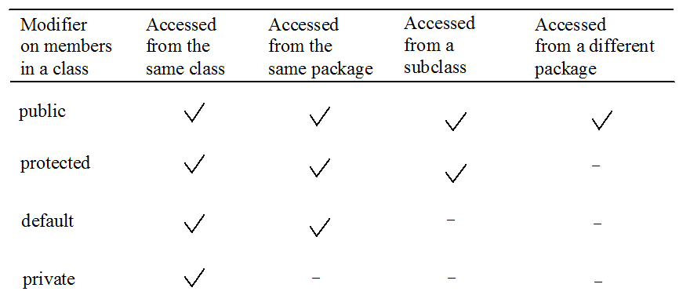
Visibility Modifiers

Slide 29
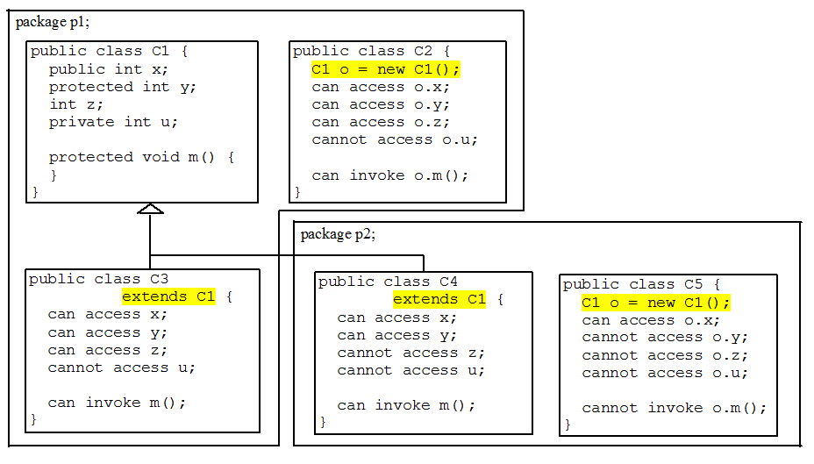
Visibility Modifiers

Slide 30
A Subclass Cannot Weaken the Accessibility
A subclass may override a protected method in its superclass and change its visibility to public. However, a subclass cannot weaken the accessibility of a method defined in the superclass. For example, if a method is defined as public in the superclass, it must be defined as public in the subclass

Slide 31
Activity (solution)
Any error in this program?
public class Apple extends Fruit {
}
class Fruit {
public Fruit(String name) {
System.out.println("Fruit's constructor is invoked");
}
}
No no-arg constructor in Fruit

Slide 32
Activity (solution)
Fruit fruit = new GoldenDelicious();
fruit instanceof Fruit? true
fruit instanceof Orange? false
fruit instanceof Apple? true
fruit instanceof GoldenDelicious? true
fruit instanceof McIntosh? false

